Slide 1
UNIT 5
Transaction Processing

Slide 2
Chapter Outline
What is Transaction?
What are ACID Properties?
Transaction states
Problems with Concurrency
Conflict and View Serializability

Slide 3
What is a Transaction?
In DBMS concepts such as ER diagrams, Conversion to the relational model, relational algebra, etc. are related to the design and development of DBMS. However, transaction processing is related to the maintenance part of DBMS. As DBMS is software so we can divide its concepts related to development and maintenance.
Example: A program is a set of instructions and lets us assume a program with 100 instructions. In the Operating system context if the program fails let's say after 60 instructions, then OS has the logic for what to do after it. However, in DBMS, either the set of instructions is completely executed or none of them is executed.
Consider the following transaction T1: R(A)
A=A-10
W(A)
R(B)
B=B+10
W(B)
As per programmer out of 6 5 instructions are executed successfully, however as per client the final result is not obtained. Thus, it is not a successful transaction.

Slide 4
What is a Transaction?
A logical unit of database processing that includes one or more access operations (read -retrieval, write - insert or update, delete).
A transaction (set of operations) may be stand-alone specified in a high-level language like SQL submitted interactively or may be embedded within a program.
Transaction boundaries
Begin and End transaction.
An application program may contain several transactions separated by the Begin and End transaction boundaries.
SIMPLE MODEL OF A DATABASE (for purposes of discussing transactions):
A database is a collection of named data items
The granularity of data - a field, a record, or a whole disk block (Concepts are independent of granularity)/Size of data item allowed to be locked
Basic operations are read and write
read_item(X): Reads a database item named X into a program variable. To simplify our notation, we assume that the program variable is also named X.
write_item(X): Writes the value of program variable X into the database item named X.

Slide 5
READ AND WRITE OPERATIONS
The basic unit of data transfer from the disk to the computer’s main memory is one block. In general, a data item (what is read or written) will be the field of some record in the database, although it may be a larger unit such as a record or even a whole block.
read_item(X) command includes the following steps:
Find the address of the disk block that contains an item, X.
Copy that disk block into a buffer in the main memory (if that disk block is not already in some main memory buffer).
Copy item X from the buffer to the program variable named X.
write_item(X) command includes the following steps:
Find the address of the disk block that contains an item, X.
Copy that disk block into a buffer in the main memory (if that disk block is not already in some main memory buffer).
Copy item X from the program variable named X into its correct location in the buffer.
Store the updated block from the buffer back to disk (either immediately or at some later point in time)

Slide 6
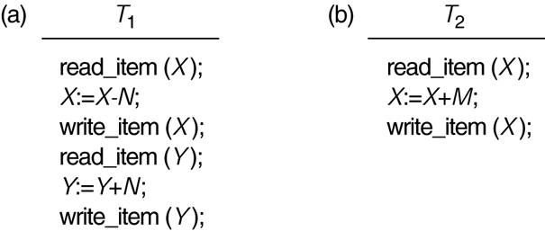
Two Sample Transactions
The transactions are always atomic in nature i.e., either all or none instructions are executed.

Slide 7
ACID properties
Consider a database in a consistent state and operations are performed on it, then it can become inconsistent. This is because a transaction ‘T’ occurs on a database. Thus, the transaction must be in such a way that database remains consistent.
Atomicity
T1
OP1
OP2
OP3
OP4
OP5
Either All are executed or None. Rollback if failure occurs
A transaction is an atomic unit of processing, either it should be performed in its eternity or not performed at all. It is the responsibility of the recovery control manager or transaction control manager of DBMS to ensure atomicity.

Slide 8
2. Isolation
A transaction should appear as though it is being executed in isolation from other transactions, even though many transactions are executing concurrently. That is the execution of a transaction should not be interfered with by any other transaction executing concurrently. The isolation property of the database is the responsibility of the Concurrency control manager of the database.
Here we talk about logical isolation, not physical isolation.
3. Durability
The changes applied to the database by the committed transaction must persist in the database. These changes must not be lost because of any failure. It is the responsibility of the Recovery control manager of DBMS.
4. Consistency
If a transaction occurs completely without the interference of the other transactions, then it should bring the database from one consistent state to another consistent state. The preservation of consistency of the database is the responsibility of users or DBMS modules that enforce integrity constraints.
If there is atomicity, isolation, and durability then consistency holds good.

Slide 9
Transaction states
Permanent state
Read write operations
Partially committed
committed
Active
Failure
Terminated
Failure
Failed
Aborted
Active: Transaction remains in this state while it is executing. It is the initial state of the transaction.
Partially Committed: When all the read and write operations are performed then the transaction reaches the partially committed state. The part of the database on which the transaction must be performed is copied into the local buffer/main memory and then the changes are made. In case the instructions are to be rollback then the copy is discarded, and the database remains intact. Although all the instructions are executed. However, the changes have not yet been updated in the database hence the state is partially committed.

Slide 10
Failed state: All databases are vulnerable to hardware and software failures and due to these when the transactions can no longer proceed it reaches a failed state.
Aborted and committed states: When the transaction is rolled back, and the database has reached its previous state then it is the aborted state and when all the operations are executed, and the changes are updated in the database then it is the committed state. In both the states aborted and committed states of the transaction, the system is in a consistent state.
Terminated: When no changes or all the changes are done in the database the transaction terminates.
Note: Committed transactions can not be rolled back. However, we can run another transaction called a compensating transaction to nullify the effect of the committed transaction.

Slide 11
What is concurrency control in DBMS?
A transaction is a single reasonable unit of work that can retrieve or may change the data of a database.
Executing each transaction individually increases the waiting time for the other transactions and the overall execution also gets delayed. Hence, to increase the throughput and reduce the waiting time, transactions are executed concurrently.
When several transactions execute simultaneously, then there is a risk of violation of the data integrity of several databases.
Concurrency Control in DBMS is a procedure of managing simultaneous transactions ensuring their atomicity, isolation, consistency, and serializability.

Slide 12
Concurrent Execution in DBMS
In a multi-user system, multiple users can access and use the same database at one time, which is known as the concurrent execution of the database. It means that the same database is executed simultaneously on a multi-user system by different users.
While working on the database transactions, there occurs the requirement of using the database by multiple users for performing different operations, and in that case, concurrent execution of the database is performed.
The thing is that the simultaneous execution that is performed should be done in an interleaved manner, and no operation should affect the other executing operations, thus maintaining the consistency of the database

Slide 13
Advantages of Concurrency
When in a system multiple transactions are running then they are called concurrent transactions. Concurrency is desirable or it cannot be compromised in the database systems.
Reduced waiting time
Reduced response time
Efficient resource utilization
Increased Efficiency
Problems of Concurrency
Dirty Read Problem:
Both are in active state
T1 T2
R(A)
A=A+1
W(A)
R(A)
C
10
10+1=11
UNDO
11(It is read from the local buffer)- DIRTY READ
If Failure occurs

Slide 14
Dirty Read Problem
When a transaction is reading a value from an uncommitted transaction (T1) and later that transaction fails (T1). In this, the transaction (T2) has read the value that does not exist in the database. It is called a dirty read. To solve the dirty read problem T2 should commit after T1.
Unrepeatable Read
T1 T2
10 (DB) R(X)
R(X) -→10
11 (Local buffer) X++
W(X)
R(X)-→ 11
Phantom Read
T1 T2
10 (Local
Buffer) R(X)
R(X) -→10
Delete(X)
R(X)-→ Variable does not exist

Slide 15
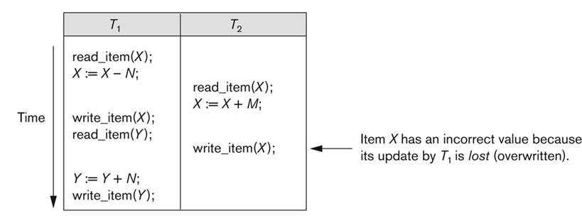
Lost Update problem or Write-write conflict

Slide 16
Identify the concurrency problems in the following scenarios
Time | A | B
T1 | READ(DT) | ------
T2 | DT=DT+500 | ------
T3 | WRITE(DT) | ------
T4 | ------ | READ(DT)
T5 | ------ | COMMIT
T6 | ROLLBACK | ------
Time | A | B
T1 | READ(DT) | ------
T2 | ------ | READ(DT)
T3 | DT=DT+500 | ------
T4 | WRITE(DT) | ------
T5 | ------ | READ(DT)

Slide 17
Time | A | B
T1 | READ(DT) | ------
T2 | ------ | READ(DT)
T3 | DELETE(DT) | ------
T4 | ------ | READ(DT)
Time | A | B
T1 | READ(DT) | ------
T2 | DT=DT+500 | ------
T3 | WRITE(DT) | ------
T4 | ------ | DT=DT+300
T5 | ------ | WRITE(DT)
T6 | READ(DT) | ------

Slide 18
Time | A | B
T1 | READ(DT1) | ------
T2 | add=0 | ------
T3 | add=add+DT1 | ------
T4 | ------ | READ(DT2)
T5 | ------ | DT2=DT2+500
T6 | READ(DT2) | ------
T7 | add=add+DT2 | ------

Slide 19
The solution to the concurrency problem is a SCHEDULE of transactions.
When two or more transactions are executed one after another then they can be bundled up in a higher unit of execution called schedule.
A schedule of n transactions T1, T2…..Tn is the ordering of operations of transactions. Operations from different transactions can be interleaved in schedule S.

Slide 20
Serial schedule
Non-Serial schedule
n1
n2
Total instructions in schedule:
n1+n2
In a schedule, context switching is allowed however we can’t change the sequential order of operations in a transaction. Also, there can’t be parallel operations in transactions as it is a uniprocessor system.

Slide 21
If we have T₁………………T_{n} transactions, then the number of possible serial schedules are--→ n!
For non-serial schedules:
It is important to know the number of instructions in each transaction along with the number of transactions
Total number of instructions= n₁+n₂+……………n_{n}
Total possible arrangements =(n₁+n₂+……………………….n_{n})!
In this we have also included those arrangements where we are swapping instructions within the transactions, so we divide it by n₁!.n₂!...................n_{n}! And subtract the total possible number of serial schedules from it.
Total non-serial schedules = (n₁+n₂+……………………….n_{n})!
- n!
n₁!.n₂!...................n_{n}!

Slide 22
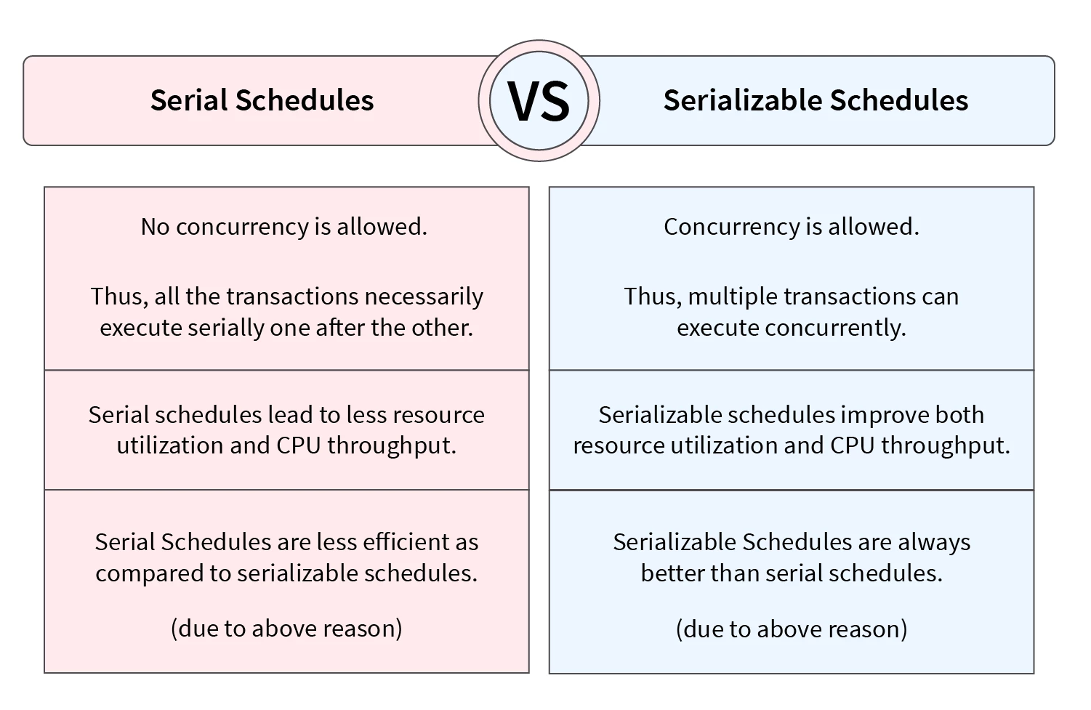

Slide 23
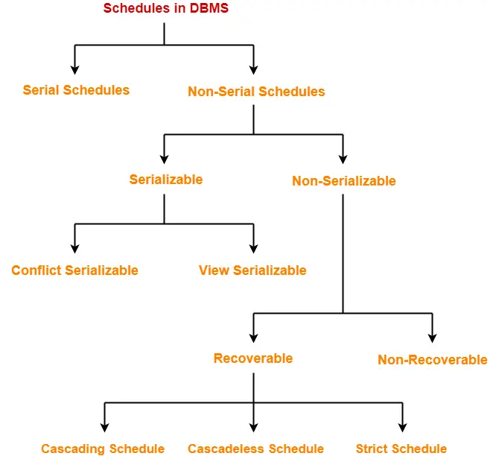

Slide 24
Although serial schedules are low in efficiency and concurrency, they guarantee consistency when participating transactions have ACID properties.
In a non-serial schedule, the order of operations should be such that it guarantees consistency.
Thus, if we prove that a non-serial schedule is equivalent to a serial schedule, consistency is ensured. Such schedules are called conflict serializable.
Conflict Serializable Schedule with precedence graph
We have different ways to prove a non-serial schedule equivalent to a serial schedule:
1) Conflict serializability
2) View Serializability.
To Remember
The sequential order of operations of individual transactions can not be changed so we can not do it while trying to make a non-serial schedule, a serial schedule.
We can change the order of operations of different transactions i.e., swapping of operations of different transactions.
IS IT ALWAYS POSSIBLE? IF No, WHEN TO SWAP?

Slide 25
Two transactions Ti and Tj having instructions Ii and Ij which we plan to swap are called non-conflicting instructions and the ones which we can not swap are conflicting instructions.
The instructions that we consider while making a serial equivalent schedule are non-conflicting instructions.
How to find non-conflicting instructions?
The approach is to find the conflicting instructions and the remaining will be non-conflicting instructions.
The two instructions may be conflicting (can’t be swapped) if:
a) Instructions belong to different transactions.
b) Operate on the same data value
c) One of them is write instructions. There can never be a read-read conflict as there is no change in the data.
To conclude, let’s take two operations on data: "a". The conflicting pairs are:
READ(a) - WRITE(a)
WRITE(a) - WRITE(a)
WRITE(a) - READ(a)

Slide 26
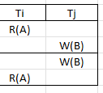
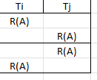
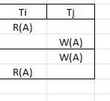
The instructions are working on different data items so these are non-conflicting instructions.
No clash if the instructions are the read instructions
Read from local buffer
If two instructions belonging to different transactions and operating on same data value and one of them is a write instruction, then we can’t swap as it will not result in proper ordering of instructions-CONFLICTING INSTRUCTIONS.
Read from Database
Swapping not possible

Slide 27
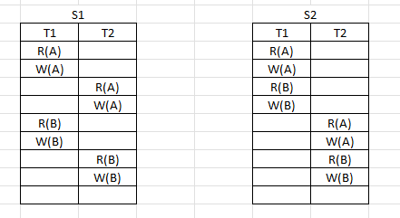
Example
Different transactions- YES
Same Data item-NO
Write Operation-YES
Thus, NON-Conflicting.
SAME
Check for swapping
SAME
When we convert a non-serial schedule in a serial schedule by swapping of non-conflicting instructions the schedule is known to be conflict serializable i.e., it guarantees consistency.

Slide 28
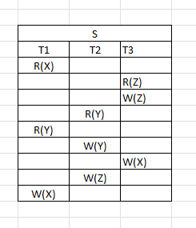
Practice problem 1
T1
T2
Cycle (Not conflict serializable)
T3
In a schedule we study instructions from top to bottom while converting it into precedence graph.

Slide 29
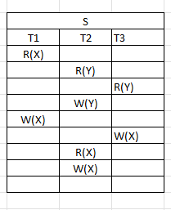
Practice problem 2
T1
T2
Schedule is conflict serializable as there is no cycle in the graph
T3
Order of serializability: T1, T3 and T2

Slide 30
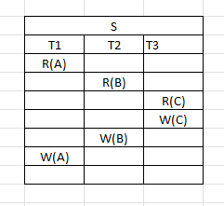
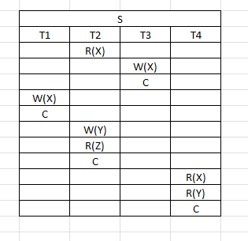
Practice problems 3 and 4

Slide 31
View Serializability is a procedure to check if the given schedule is consistent or not.
It is performed only if the given schedule is not conflict-serializable.
It is important to check the consistency of the schedule as an inconsistent schedule leads to an inconsistent state of the program which is undesirable.
What is View Serializability?
A system handles multiple transactions running concurrently, there is a possibility that a few of them leaves the system databases in an inconsistent state and thus, the system fails.
To be aware of such schedules and save the system from failures, we check if schedules are serializable or not. If the given schedule is serializable implies it will never leave the database in an inconsistent state.
Serial schedules are the schedules where no two transactions are executed concurrently.
Thus, serial schedules never leave the database in an inconsistent state. If the given schedule is view serializable, then we are sure that it is a consistent schedule or serial schedule.

Slide 32
View Serializability is a process used to check whether the given schedule is view serializable or not. To do so we check if the given schedule is View Equivalent to its serial schedule.
There is a possibility that even though the schedule is not conflict serializable, it gives a consistent result.
This is because conflict serializability is limited to the precedence graph of a schedule.
If the precedence graph contains any loops/cycles, we cannot predict whether a schedule is consistent or inconsistent.
If its precedence graph doesn't contain any loop/cycle given schedule is consistent, but if it contains a loop/cycle then the schedule may or may not be consistent.
To figure out the state of the schedule, we use the concept of View-Serializability because we do not want to bind the concept of Serializability only to Conflict with Serializability.
If the given schedule is not conflict serializable, then we need to check for View Serializability. If it is view serializable then it is consistent else, it is inconsistent. Thus, to address the limitations of conflict serializability, the concept of view-serializability was introduced.

Slide 33
Methods to Check View Serializability
There are two methods to check View Serializability.
Method 1: View Equivalent
If the given schedule is view-equivalent to the serial schedule itself, then we can say that the schedule is view-serializable.
To generate the serial schedule of the given schedule, we follow the following steps:
Take the transaction say Ti that performs any operation first in the schedule.
Write all the operations performed by that transaction one after the other in the given schedule.
Similarly, take another transaction that is performing any operation right after Ti in the given schedule and write all the operations performed by it below transaction Ti on any data item.
Follow the above steps for all the transactions. The order is very important.

Slide 34
Schedule S1
Schedule S2 –Equivalent Serial schedule
T1 | T2
R(X)
X=X+10
W(A)
 | R(X)
 | X=X+10
 | W(X)
R(Y)
Y=Y+20
W(Y)
 | R(Y)
 | Y=Y*1.1
 | W(Y)
T1 | T2
R(X)
X=X+10
W(A)
R(Y)
Y=Y+20
W(Y)
 | R(X)
 | X=X+10
 | W(X)
 | R(Y)
 | Y=Y*1.1
 | W(Y)

Slide 35
Two schedules are said to view equivalent if they satisfy the following three conditions:
Condition 1: Initial Read
Initially if transaction T1 of Schedule S1 reads data item X, then transaction T1 of Schedule S2 must read data item X initially as well.
In the example above, the Initial read is made by the T1 transaction for both the data items X and Y in Schedule S1 and in S2 as well initial read is made by transaction T1 for both.
Thus, the initial read condition is satisfied in S1 and S2 for data items X and Y.
Condition 2: Update Read
If transaction Ti is reading updated data item X by transaction Tj in S1, then in Schedule S2 Ti should read X which is updated by Tj.
Value of X and Y is updated by transaction T1 in schedule S1, which is read by transaction T2.
In Schedule S2 the X and Y data items are updated by T1 and are read by T2 as well.
Thus, in the above two schedules, the update read condition is also satisfied.

Slide 36
Condition 3: Final Write
If transaction T1 updates data item Y at last in S1, then in S2 also, T1 should perform the final write operation on Y.
The final write for data items X and Y are made by Transaction T2 in Schedule S1.
Also, the final write is made by T2 in Schedule S2 in Schedule S1 as well as serial schedule S2.
Thus, the condition for the final write is also satisfied.
Result
As all the three conditions are satisfied for our schedule S1 and its Serial Schedule S2, they are view equivalent. Thus, we can say that the given schedule S1 is the view-serializable schedule and is consistent.

Slide 37
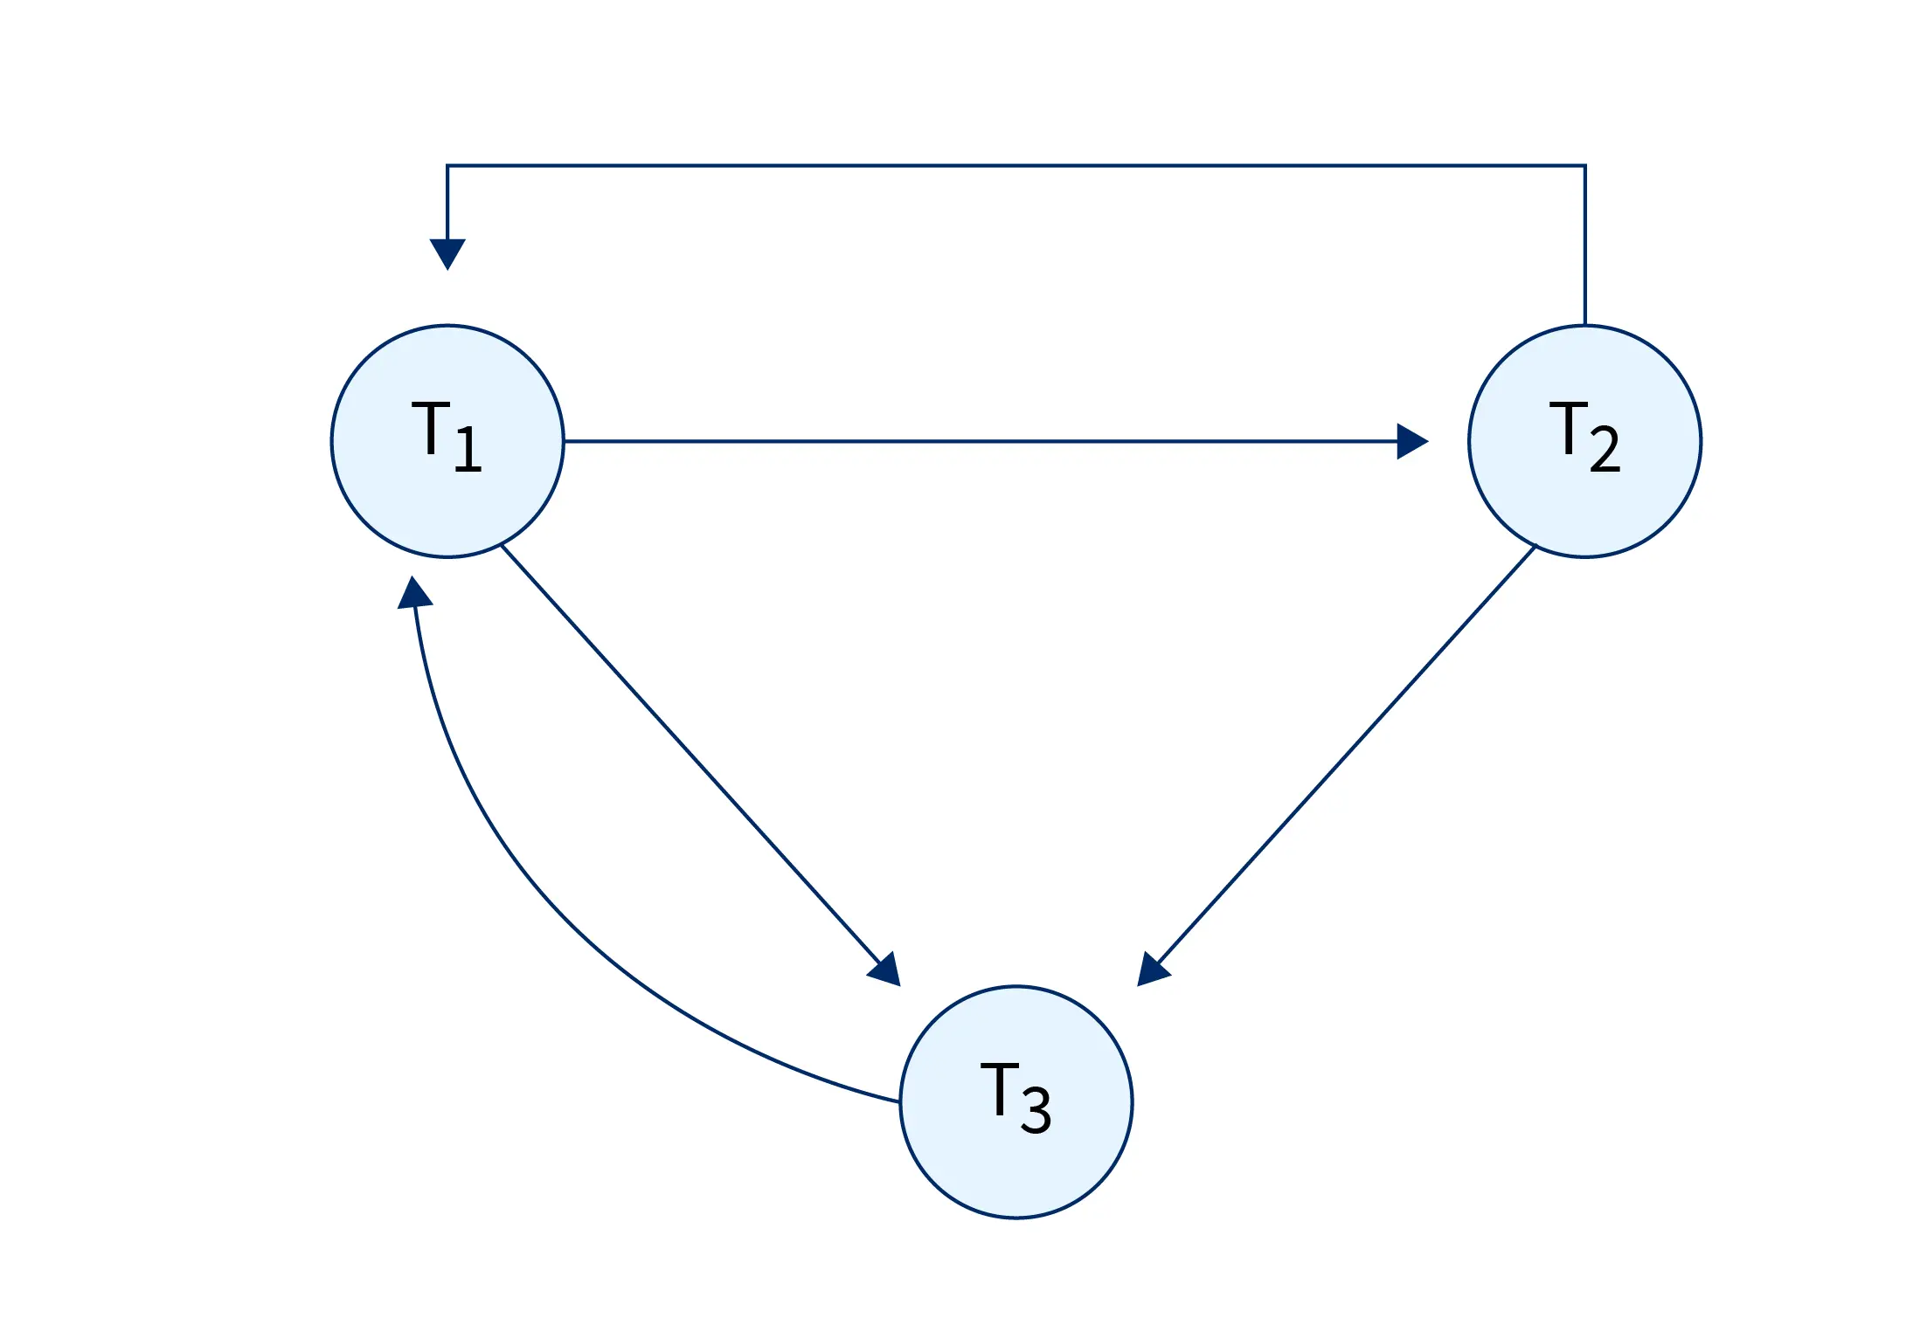
Method 2: Check the View-Serializability of a Schedule
STEP 1: Check the conflict serializability of the schedule by creating the precedence graph.
T1 | T2 | T3
R(X)
 | W(X)
 |  | R(X)
W(X)
 |  | W(X)
Writing all the conflicting operations:
R1(X), W2(X) (T1 → T2)
R1(X), W3(X) (T1 → T3)
W2(X), R3(X) (T2 → T3)
W2(X), W1(X) (T2 → T1)
W2(X), W3(X) (T2 → T3)
R3(X), W1(X) (T3 → T1)
W1(X), W3(X) (T1 → T3)

Slide 38
STEP 2: Next, we will check for blind writes.
If the blind writes don't exist, then the schedule is non-view Serializable. We can simply conclude that the given schedule is inconsistent.
In the above example, transaction T2 contains a blind write, thus we are not sure if the given schedule is view-serializable or not.
STEP 3: Lastly, we will draw a dependency graph for the schedule.
Note: The dependency graph is different from the precedence graph.
Steps for dependency graph:
Firstly, T1 reads X, and T2 first updates X. So, T1 must execute before the T2 operation. (T1 → T2)
T3 performs the final updation on X thus, T3 must execute after T1 and T2. (T1 → T3 and T2 → T3)
T2 updates X before T3, so we get the dependency as (T2 → T3)

Slide 39
As no cycles exist in the dependency graph for the example, we can say that the schedule is view-serializable.
If any cycle/ loop exists, then it is not view-serializable, and the schedule is inconsistent.
If cycle/loop doesn't exist, then it is view-serializable.

Slide 40
Conclusion
View Serializability is a long process to check the consistency of the given schedule.
If the given schedule is conflict serializable, then it is view-serializable as well. The opposite is not true.
There are two methods to check if the given schedule is View Serializable, one is using the serial schedule, and another uses blind writes and dependency graphs.

Slide 41
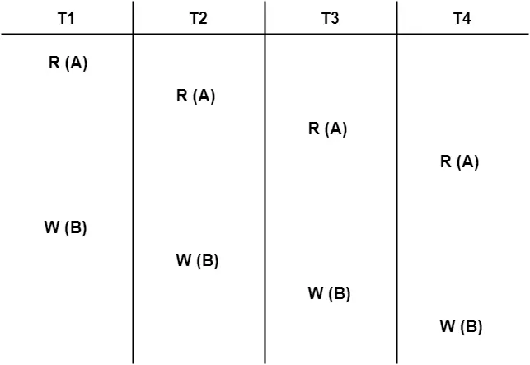
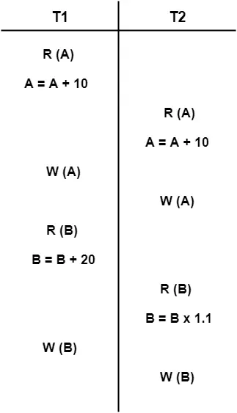
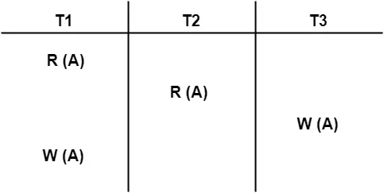
PRACTICE PROBLEMS BASED ON VIEW SERIALIZABILITY
Check whether the given schedule S is view serializable or not-
Problem-02:
Problem-03:
Problem-01:

Slide 42
Non-Serializability in DBMS
A non-serial schedule that is not serializable is called a non-serializable schedule.
Non-serializable schedules may/may not be consistent or recoverable.
Non-serializable Schedule is divided into types:
Recoverable Schedule
Non-recoverable Schedule
Recoverability in DBMS
In Database Management Systems there are multiple transactions that are happening parallelly.
Some of these transactions are dependent on each other while some are independent.
If one transaction fails in the dependent transactions, can we minimize its impact on other transactions as well? Recoverability in DBMS is an area that deals with such kind of issues.

Slide 43

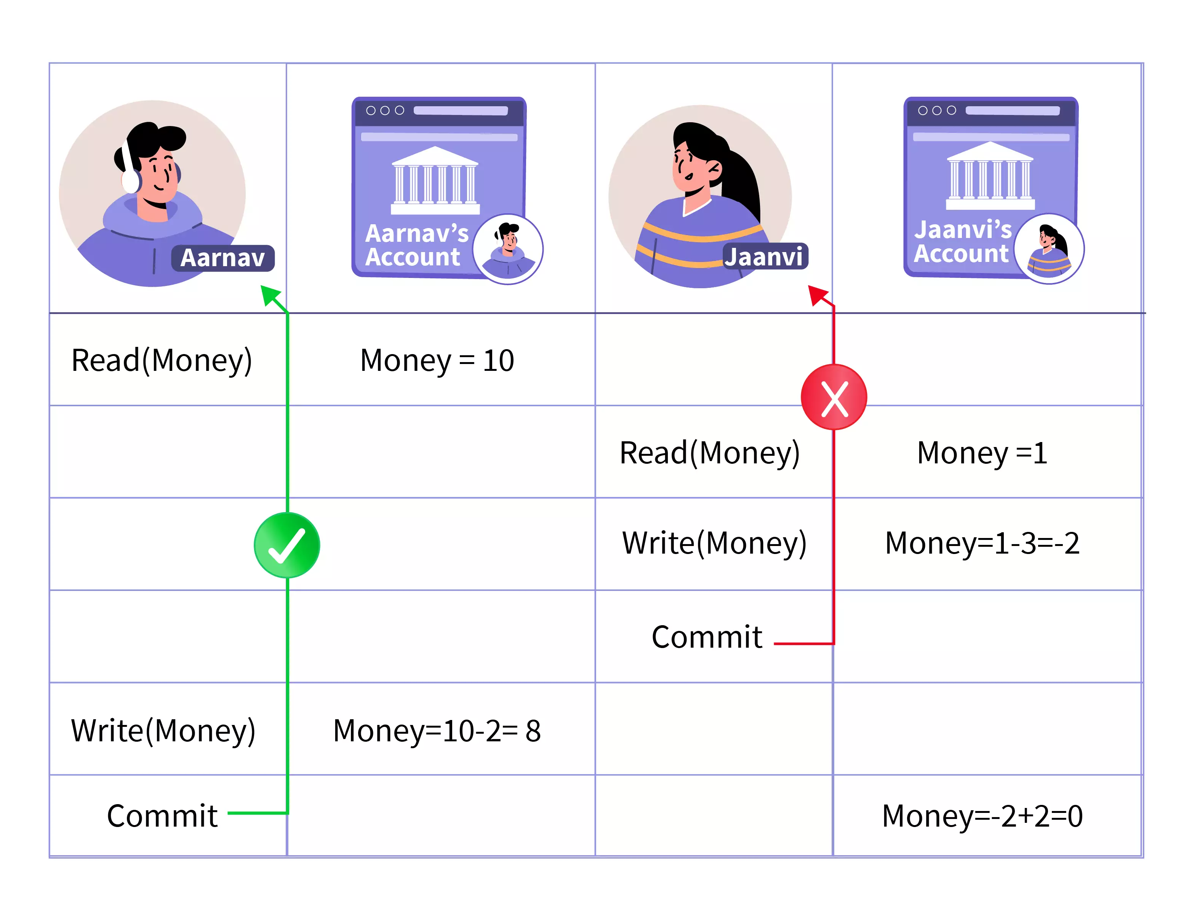
Recoverable Schedule
Transaction in their bank account
Suppose Aarnav has 10 lakhs in his account and his friend Jaanvi who has 1 lakh in her account, needs 2 lakhs more to buy a new gaming laptop.
The laptop is a limited edition, and once she places the order, she cannot cancel it. The money can be paid only within 30 minutes of placing the order. She texted Aarnav to transfer her 2 lakhs and placed an order for the 3-lakh gaming laptop.

Slide 44
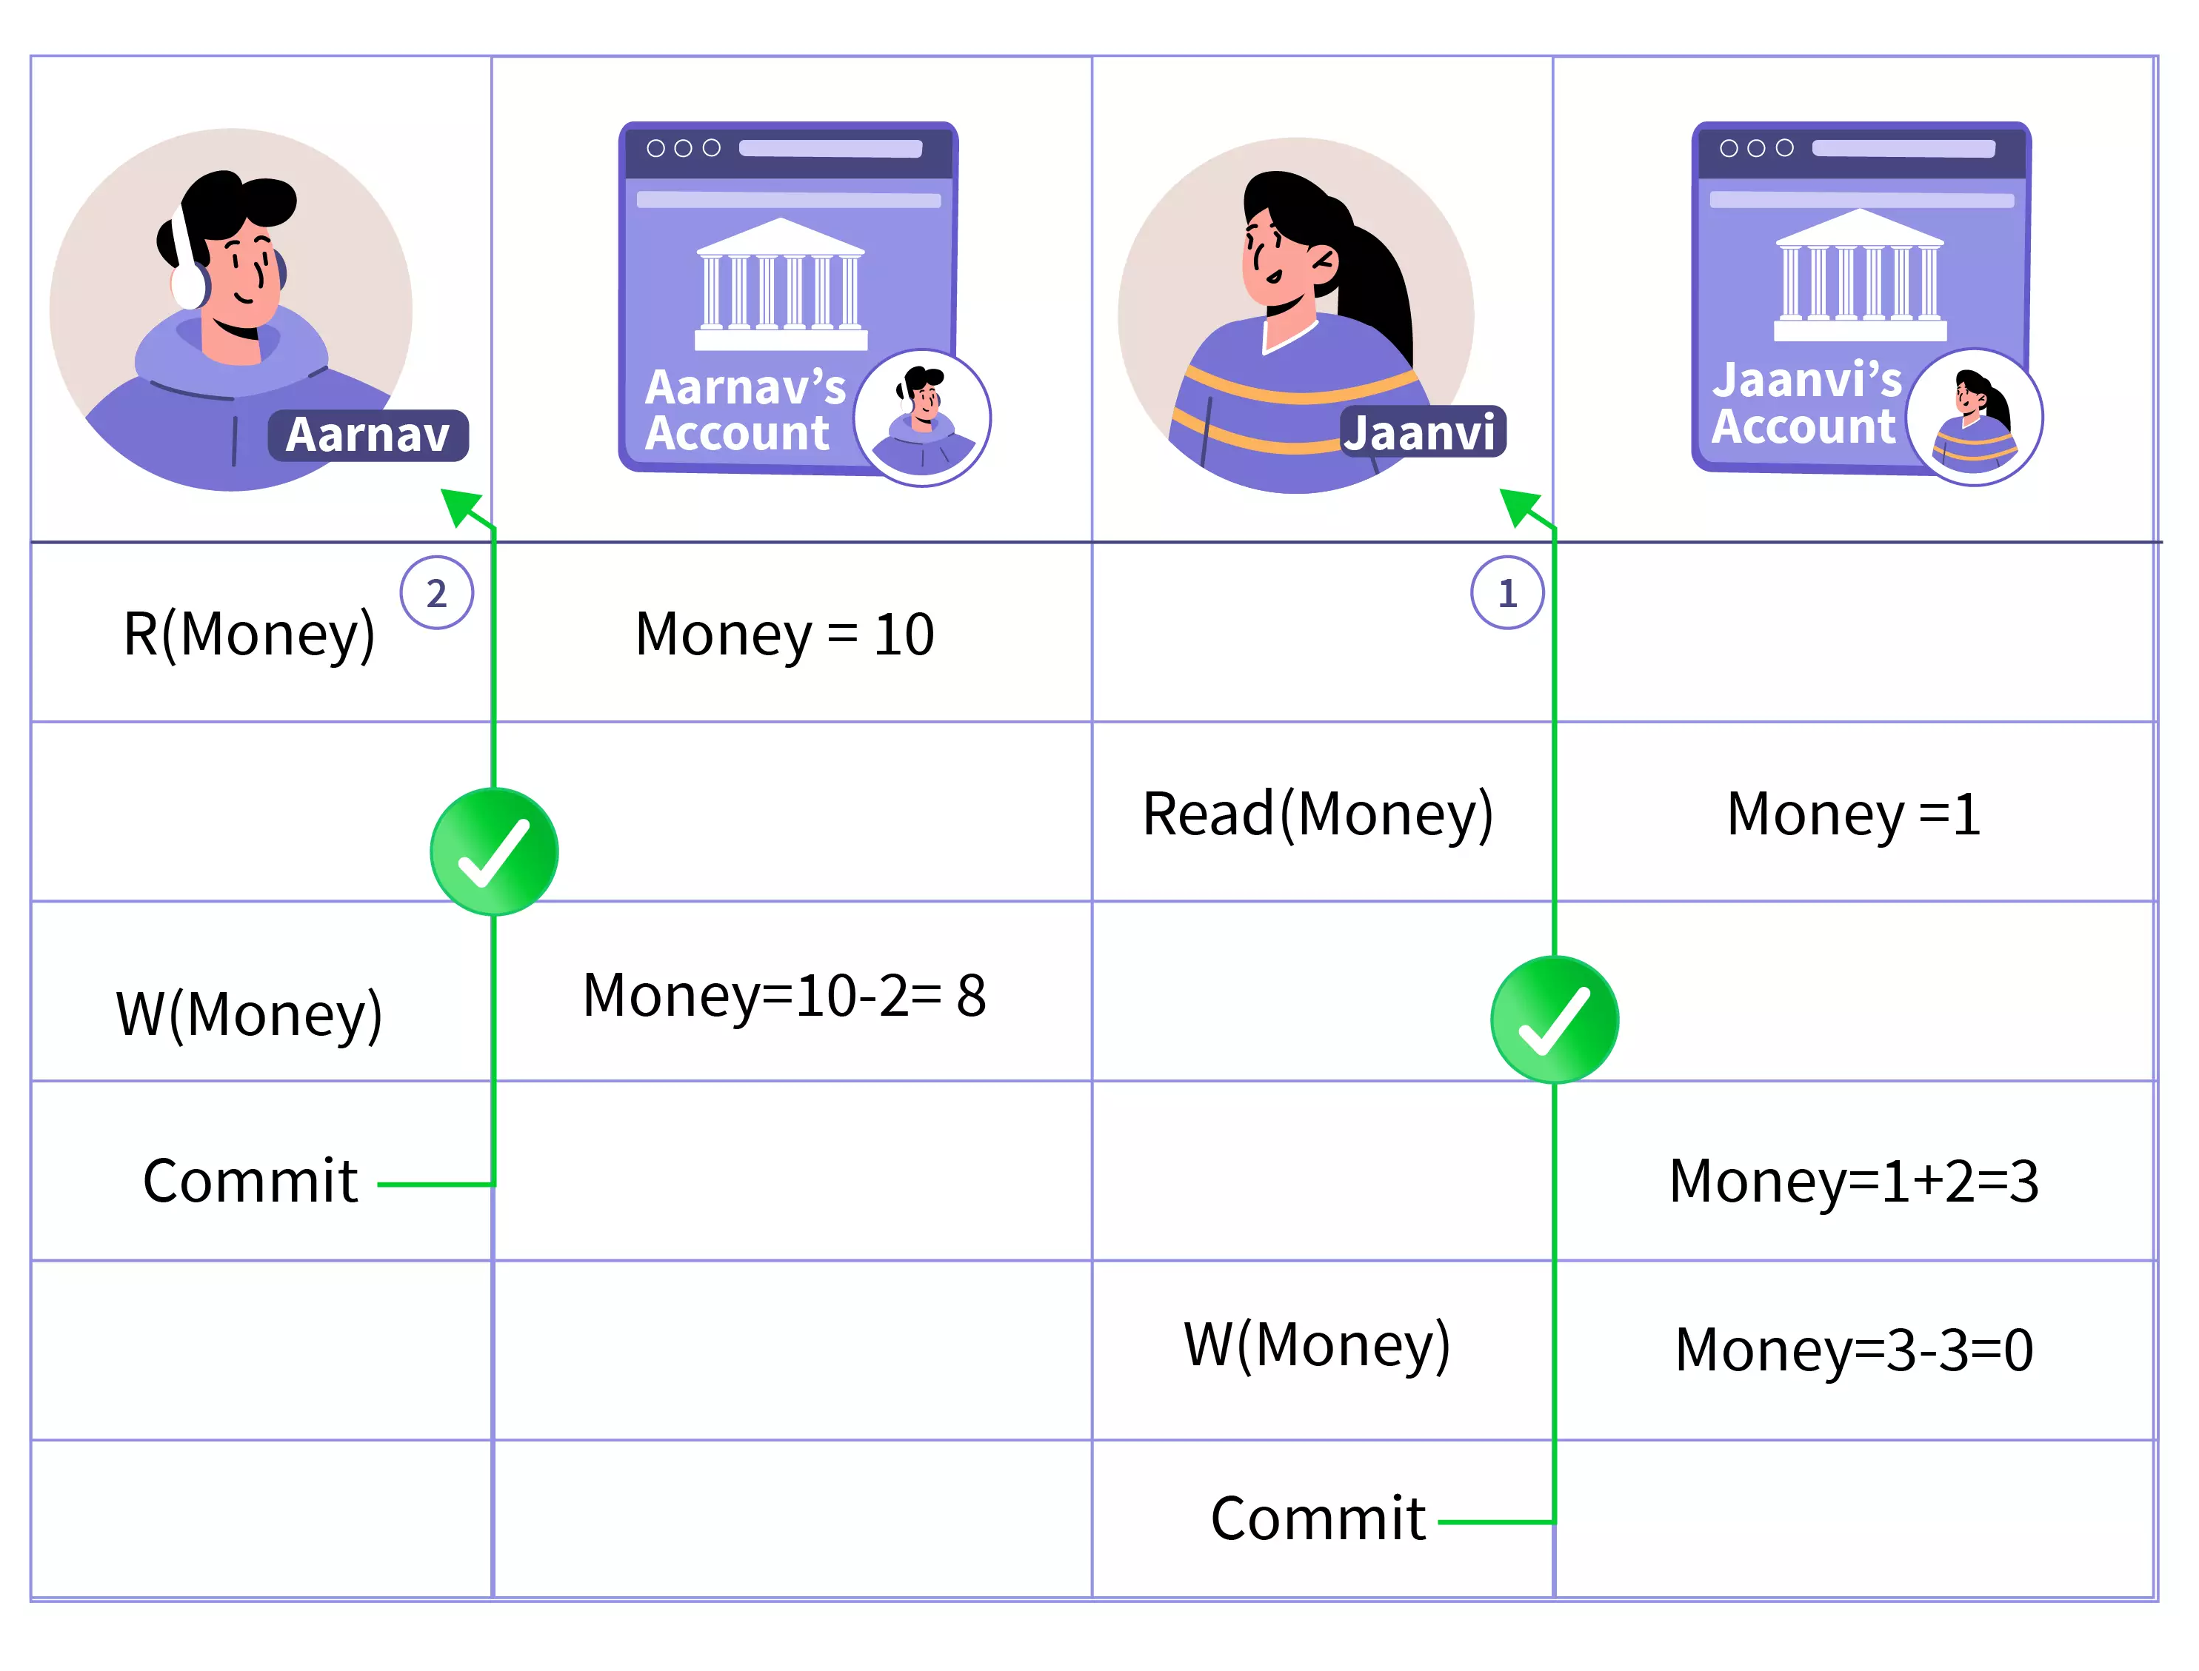
If Aarnav doesn't transfer the money to Jaanvi, Jaanvi may get in trouble since she can't cancel the order and does not have money. Hence, a wise decision would have been to place an order when she receives 2 lakhs from Aarnav.
Therefore, if Jaanvi places the order once she receives the money from Aarnav can be considered a recoverable schedule since she has the option of whether to place the order or not.

Slide 45
Recoverable Schedule
(T1​→T2​ Reads)⟹(T1​ Commits→T2​ Commits)
Irrecoverable Schedule
(T1​→T2​ Reads)⟹(T2​ Commits→T1​ Commits)

Slide 46
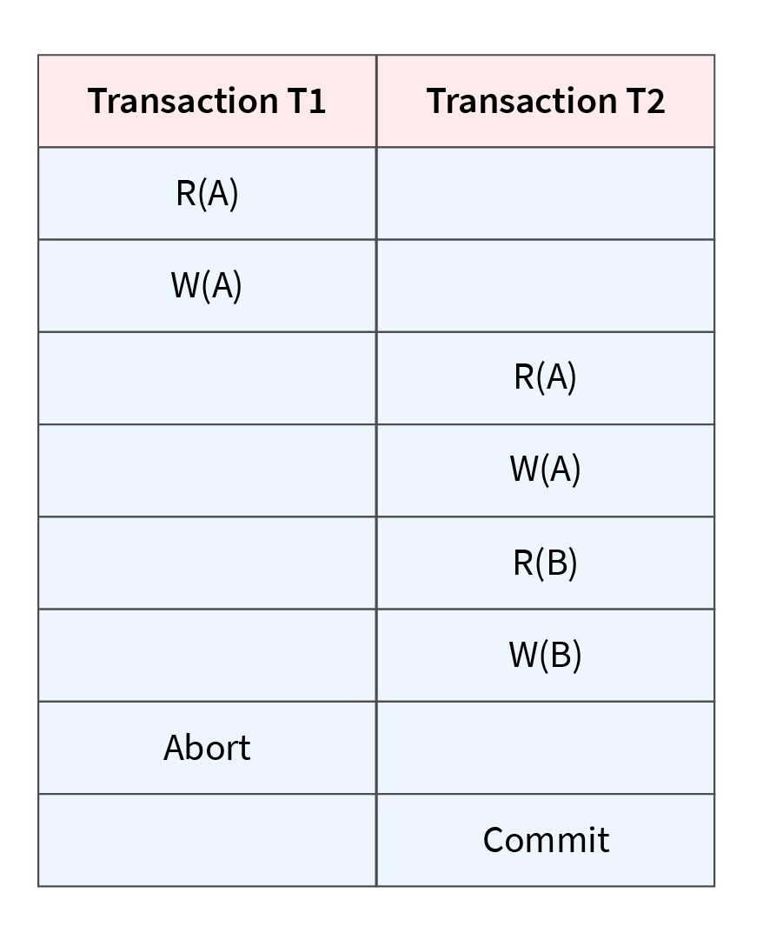
Recoverable Schedule
A schedule is recoverable if each transaction commits only after all the transactions from which it has read have committed.
In other words, if some transaction Ty reads a value that has been updated/written by some other transaction Tx, then the commit of Ty must occur after the commit of Tx.
The schedule shown above is Recoverable since T1 commits before T2, which makes the value read by T2 correct.

Slide 47
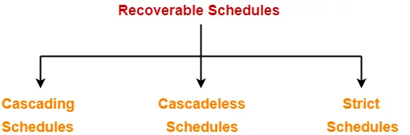
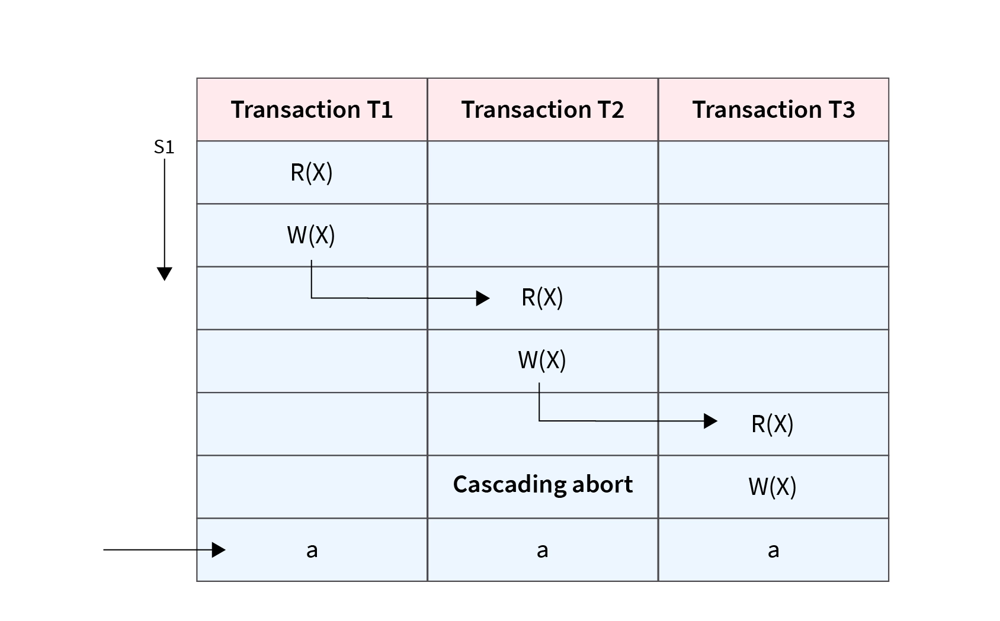
Recoverable schedules are further categorized into 3 types:
Cascading Schedule
If in a schedule, several other dependent transactions are forced to rollback/abort because of the failure of one transaction, then such a schedule is called a Cascading Schedule or Cascading Rollback or Cascading Abort.
It simply leads to the wastage of CPU time.
Here, Transaction T2 depends on transaction T1, and transaction T3 depends on transaction T2. Thus, in this Schedule, the failure of transaction T1 will cause transaction T2 to roll back, and a similar case for transaction T3.
Therefore, it is a cascading schedule. If the transactions T2 and T3 had been committed before the failure of transaction T1, then the Schedule would have been irrecoverable.

Slide 48
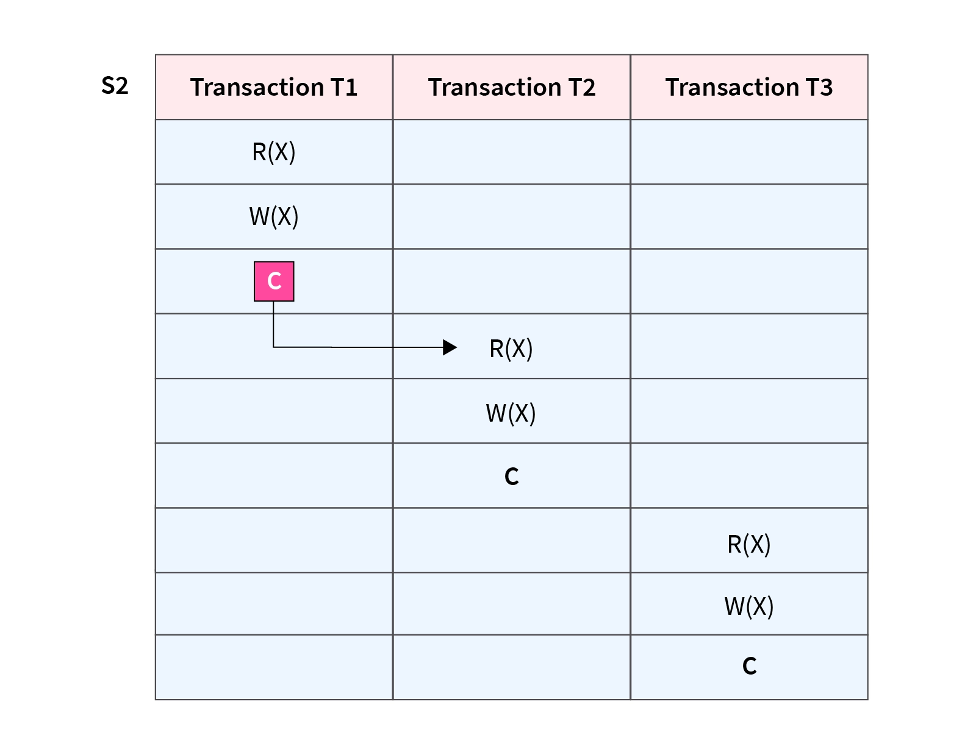
Cascadeless Schedule
If in a schedule, a transaction is not allowed to read a data item until and unless the last transaction that has been written is committed/aborted, then such a schedule is called a Cascadeless Schedule.
It avoids cascading rollback and thus saves CPU time.
To prevent cascading rollbacks, it disallows a transaction from reading uncommitted changes from another transaction in the same Schedule.
In other words, if some transaction Ty wants to read a value that has been updated or written by some other transaction Tx, then only after the commit of Tx, the commit of Ty must read it.
Here, the updated value of X is read by transaction T2 only after the commit of transaction T1.
Hence, the Schedule is a Cascadeless schedule.

Slide 49
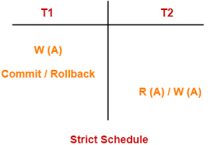
Strict Schedule
If in a schedule, until the last transaction that has been written is committed or aborted, a transaction is neither allowed to read nor write data items, then such a schedule is called a Strict Schedule.
Consider two transactions T1 and T2. The write operation of transaction T1 precedes the read or write operation of transaction T2, so the commit or abort operation of transaction T1 should also precede the read or write of T2.
A strict Schedule allows only committed read-and-write operations. This Schedule implements more restrictions than cascade less schedule.
Here, transaction T2 reads/writes the written value of transaction T1 only after the transaction T1 commits. Hence, the Schedule is strict Schedule.

Slide 50
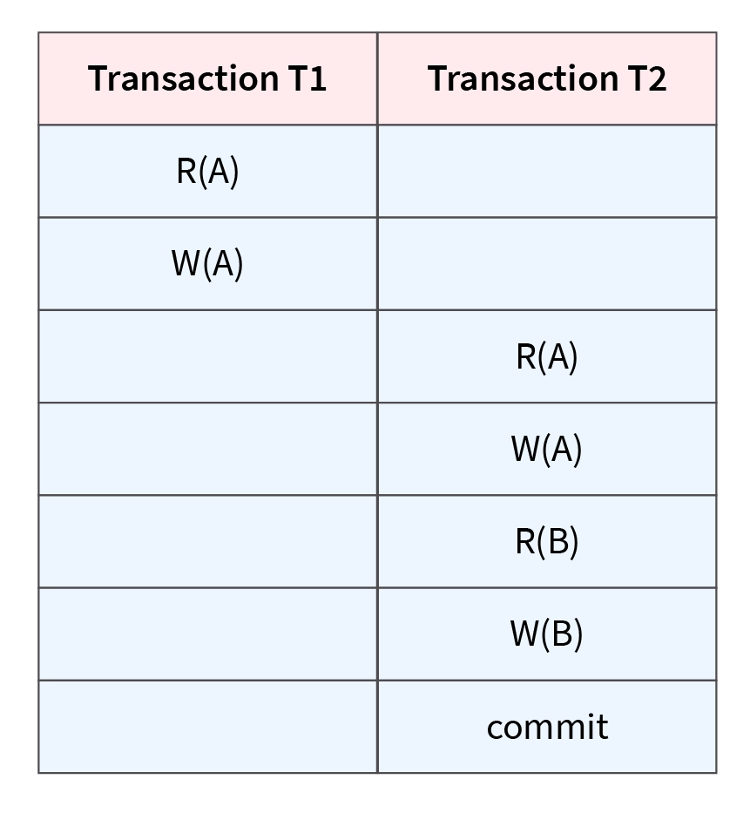
Non-Recoverable Schedule
If a transaction reads the value of an operation from an uncommitted transaction and commits before the transaction from where it has read the value, then such a schedule is called a Non-Recoverable schedule.
A non-recoverable schedule means when there is a system failure, we may not be able to recover to a consistent database state. If the commit operation of Ti doesn't occur before the commit operation of Tj, it is non-recoverable.
Consider the following Schedule involving two transactions T1 and T2. T2 read the value of A written by T1 and committed. T1 might later abort/commit; therefore, the value read by T2 is wrong, but since T2 committed, this Schedule is non-recoverable.

Slide 51
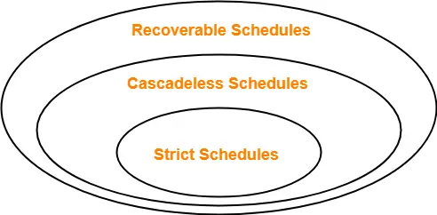
Remember-
Strict schedules are stricter than cascade-less schedules.
All strict schedules are Cascadeless schedules.
All Cascadeless schedules are not strict schedules.

Slide 52
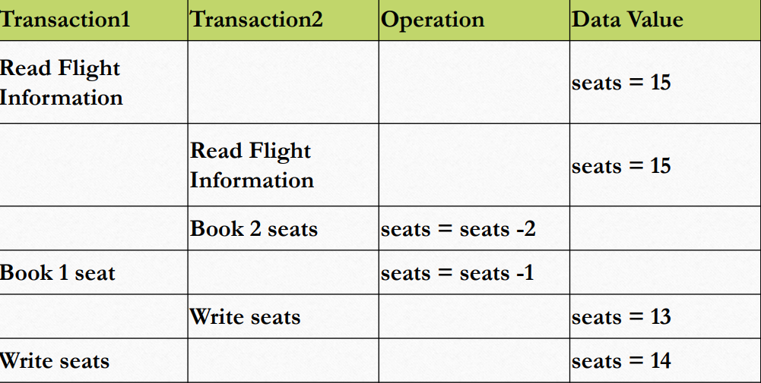
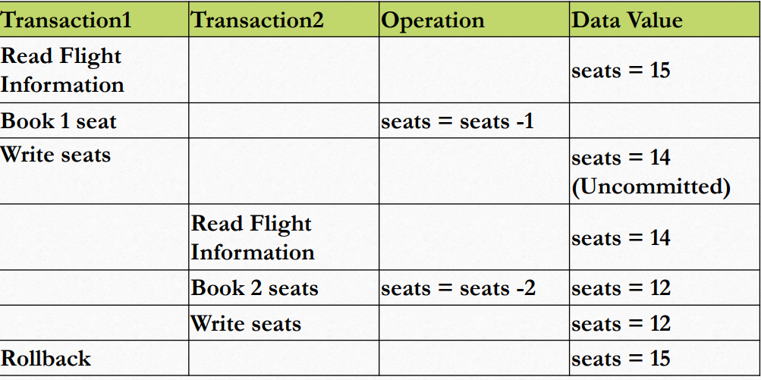
Concurrency Control Problems
LOST UPDATE
DIRTY READ

Slide 53
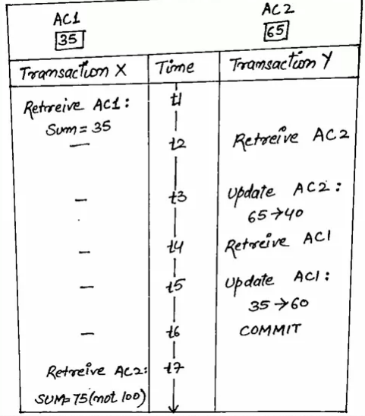
INCORRECT SUMMARY PROBLEM

Slide 54
What is Concurrency Control?
The process of managing the simultaneous execution of transactions in a shared database, to ensure the serializability of transactions, is known as concurrency control
Why we need Concurrency Control?
Simultaneous execution of transactions over a shared database can create several data integrity and consistency problems: • Lost Updates.
• Uncommitted Data.
• Inconsistent retrievals.
Pessimistic Concurrency Control
•Pessimistic Concurrency Control assumes that conflicts will happen
•Pessimistic Concurrency Control techniques detect conflicts as soon as they occur and resolve them using blocking

Slide 55
Concurrency Control Protocols
To avoid concurrency control problems and to maintain consistency and serializability during the execution of concurrent transactions some rules are made. These rules are known as Concurrency Control Protocols.
•We have concurrency control protocols to ensure the atomicity, isolation, and serializability of concurrent transactions.
Concurrency control protocols can be broadly divided into two categories −
• Lock-based protocols
•Time stamp-based protocols

Slide 56
Lock-Based Concurrency Control
A lock is a mechanism to control concurrent access to a data item
• Data items can be locked in two modes:
exclusive (X) mode. A data item can be both read as well as written. X-lock is requested using lock-X instruction.
2. shared (S) mode.
A data item can only be read. S-lock is requested using lock-S instruction.
Lock requests are made to the concurrency-control manager by the programmer.
The transaction can proceed only after the request is granted

Slide 57
Example of a transaction performing locking:
T2: lock-S(A);
read (A);
unlock(A);
lock-S(B);
read (B);
unlock(B);
display(A+B)
• Locking as above is not sufficient to guarantee serializability — if A and B get updated in between the read of A and B, the displayed sum would be wrong.
• A locking protocol is a set of rules followed by all transactions while requesting and releasing locks. Locking protocols restrict the set of possible schedules

Slide 58
Lock Based Protocols
Locks are of two kinds
1. Binary Locks: a lock on a data item can be in two states; it is either locked or unlocked.
2. Shared/exclusive: If a lock is acquired on a data item to perform a write operation, it is an exclusive lock.
3. Read locks are shared because no data value is being changed

Slide 59
There are four types of lock protocols available
Simplistic Lock Protocol
Simplistic lock-based protocols allow transactions to obtain a lock on every object before the 'write' operation is performed. As soon as 'write' has been done, transactions may unlock the data item.
Pre-claiming
In this protocol, a list of data items to be locked is generated by a transaction after evaluating its operations.
Before the execution, the transaction requests the system to lock all resources beforehand.
After the locks are granted, the execution begins and when all its operations are over locks are released. Else if all the locks are not granted, the transaction rolls back and waits until all locks are granted.
Two-Phase Locking 2PL
In this locking protocol transaction execution phase is divided into three parts. In the first part, when a transaction starts executing, it requests for locks needed for the successful execution
The second part is where the transaction acquires all locks, and no other lock is required. Transaction keeps executing its operation.
As soon as the transaction releases its first lock, the third phase starts. In this phase, a transaction cannot demand for any lock but only releases the acquired locks.

Slide 60
The Two-Phase Locking Protocol defines the rules of how to acquire the locks on a data item and how to release the locks.
The Two-Phase Locking Protocol assumes that a transaction can only be in one of two phases.
Growing Phase: In this phase, the transaction can only acquire locks, but cannot release any locks. The transaction enters the growing phase as soon as it acquires the first lock it wants. It cannot release any lock at this phase even if it has finished
working with a locked data item.
Ultimately the transaction reaches a point where all the lock it may need has been acquired. This point is called Lock Point.
Shrinking Phase: After Lock Point has been reached, the transaction enters the shrinking phase. In this phase the transaction can only release locks but cannot acquire any new locks.
The transaction enters the shrinking phase as soon as it releases the first lock after crossing the Lock Point. From now on it has no option but to keep releasing all the acquired locks

Slide 61
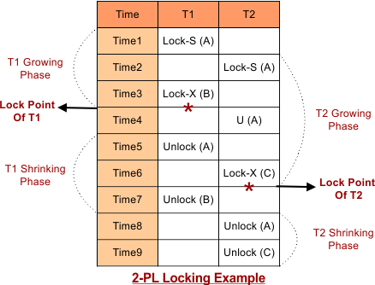

Slide 62
Strict Two-Phase Locking
The first phase of Strict-2PL is the same as 2PL. After acquiring all the locks in the first phase, the transaction continues to execute normally.
But in contrast to 2PL, Strict-2PL does not release a lock after using it.
Strict-2PL holds all the locks until the commit point and releases all the locks at a time

Slide 63
Implementation of Locking
• A lock manager can be implemented as a separate process to which transactions send lock and unlock requests
• The lock manager replies to a lock request by sending a lock grant message (or a message asking the transaction to roll back, in case of a deadlock)
• The requesting transaction waits until its request is answered
• The lock manager maintains a data structure called a lock table to record granted locks and pending requests.
• The lock table is usually implemented as an in-memory hash table indexed on the name of the data item being locked.

Slide 64
Two-Phase Locking Protocol (Basic 2PL):
This protocol requires that each transaction in a schedule will be two-phased:
Growing phase and Shrink Phase.
In the Growing phase transaction can only obtain a lock but can not release any lock.
In the shrinking phase transaction can only release the lock but can not obtain any lock.
Transactions can perform read/write operations both in the growing and shrinking phase.
Ensure CS, VS, the order of Serializability is the order in which the transaction reached the lock point.
May generate an irrecoverable schedule and cascading rollback.
Do not ensure freedom from deadlock.

Slide 65
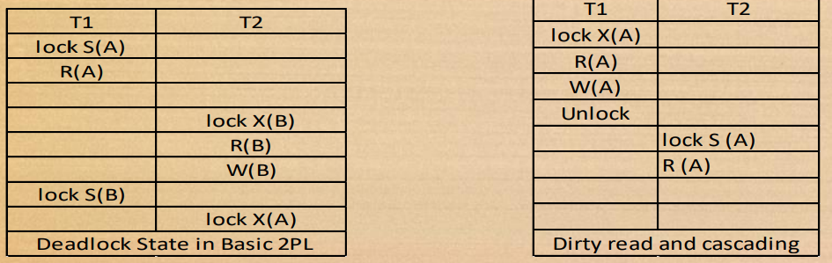

Slide 66
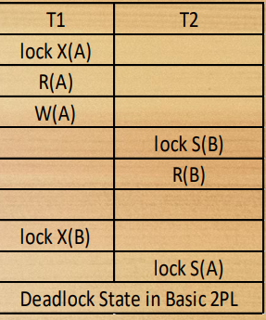
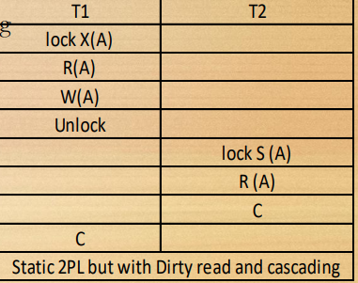
Conservative/ Static 2 PL:
There is no growing phase, the transaction first will acquire all the locks required and then directly will start from the lock point.
If all the locks are not available, then the transaction must release the lock acquired so far and wait.
The shrinking phase works as usual, and transactions can unlock any data item. Here we must have all the knowledge that what data items will be required during execution. CS, VS, independent from deadlock. Possibility of irrecoverable schedules and cascading rollback.

Slide 67
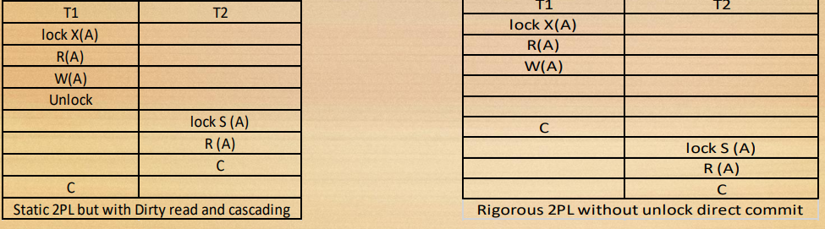
Rigorous 2PL:
• It is an improvement over the 2PL protocol where we try to ensure recoverability and cascade lessness.
• Rigorous 2PL requires that all the locks must be held until the transaction commits i.e., there is no shrinking phase in the life of a transaction.
• Will ensure CS, VS, recoverability, and cascade lessness.
• Suffer from deadlock and inefficiency.

Slide 68
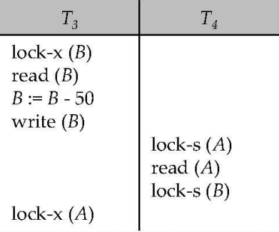
Strict 2PL:
• It is an improvement over rigorous 2PL.
• In the shrinking phase unlocking of exclusive locks are not allowed but the unlocking of shared lock can be done.
• All the properties are the same as that of rigorous 2 PL, but it provides better concurrency.
Pitfalls of Lock-Based Protocols
• Consider the partial schedule
• Neither T3 nor T4 can make progress — executing lock-S(B) causes T4 to wait for T3 to release its lock on B, while executing lock-X(A) causes T3 to wait for T4 to release its lock on A.
• Such a situation is called a deadlock.
• To handle a deadlock one of T3 or T4 must be rolled back, and its locks released.

Slide 69
Pitfalls of Lock-Based Protocols
• The potential for deadlock exists in most locking protocols.
• Deadlocks are a necessary evil.
• Starvation is also possible if the concurrency control manager is badly designed.
For example:
• A transaction may be waiting for an X-lock on an item, while a sequence of other transactions request and are granted an S-lock on the same item.
• The same transaction is repeatedly rolled back due to deadlocks.
• Concurrency control manager can be designed to prevent starvation

Slide 70
Deadlocks
A deadlock is a condition where two or more transactions are waiting indefinitely for one another to give up locks.
A Deadlock in DBMS can be termed as the undesirable condition which appears when a process waits for a resource indefinitely whereas this resource is detained by another process.
A deadlock is a condition wherein two or more tasks are waiting for each other in order to be finished but none of the task is willing to give up the resources that other task needs.

Slide 71
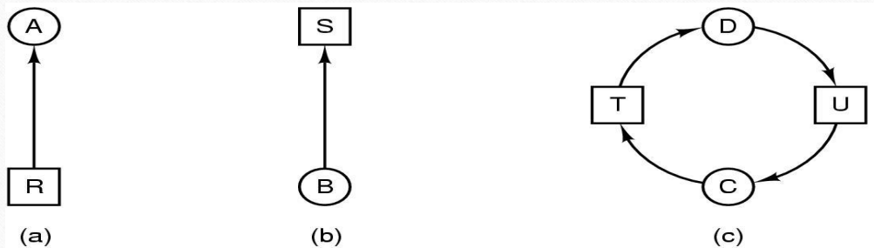
Deadlock Modeling
Modeled with directed graphs
resource R assigned to process A
process B is requesting/waiting for resource S
process C and D are in deadlock over resources T and U

Slide 72
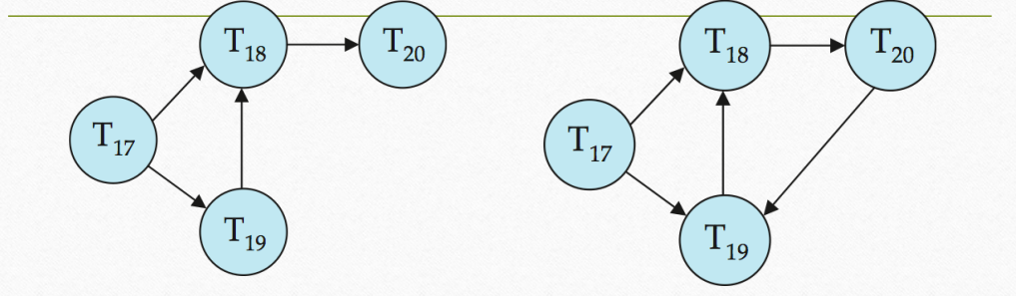
Deadlock Detection
Deadlock detection algorithms used to detect deadlocks
Wait-for graph without a cycle Wait-for graph with a cycle

Slide 73
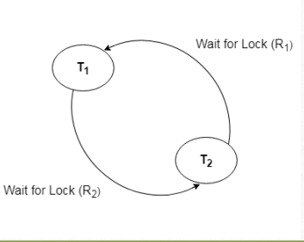
Wait for Graph
This is the suitable method for deadlock detection.
In this method, a graph is created based on the transaction and their lock. I
f the created graph has a cycle or closed loop, then there is a deadlock.
The wait for the graph is maintained by the system for every transaction which is waiting for some data held by the others.
The system keeps checking the graph if there is any cycle in the graph

Slide 74
(Coffman)Conditions for Deadlock
• Mutual exclusion condition: There must be at least one resource that cannot be used by more than one process at a time.
• Hold and wait condition: A process that is holding a resource can request for additional resources that are being held by other processes in the system.
• No preemption condition: A resource cannot be forcibly taken from a process. Only the process can release a resource that is being held by it.
• Circular wait condition: A condition where one process is waiting for a resource that is being held by second process and second process is waiting for third process ….so on and the last process is waiting for the first process.
Thus, making a circular chain of waiting.

Slide 75
Strategies for dealing with Deadlocks
• just ignore the problem altogether
• detection and recovery
• careful resource allocation
• prevention
• negating one of the four necessary condition

Slide 76
Deadlock Handling
Ignore the deadlock (Ostrich algorithm)
In this approach we ignore the deadlock and pretend that it would never occur, just like Ostrich behavior “to stick one’s head in the sand and pretend there is no problem.” it is believed that deadlocks are very rare, and cost of deadlock handling is higher, in that case ignoring is a better solution than handling it.

Slide 77
Deadlock detection
A resource scheduler is one that keeps the track of resources allocated to and requested by processes. Thus, if there is a deadlock it is known to the resource scheduler.
Once a deadlock is detected it is corrected by following methods:
Terminating processes involved in deadlock: Terminating all the processes involved in deadlock or terminating processes one by one until the deadlock is resolved can be the solution but both approaches are not good.
Terminating all processes cost high and partial work done by processes gets lost.
Terminating one by one takes a lot of time because each time a process is terminated, it needs to check whether the deadlock is resolved or not.
Thus, the best approach is to consider process age and priority while terminating them during a deadlock condition
Resource Preemption: Another approach can be the preemption of resources and allocation of them to the other processes until the deadlock is resolved.

Slide 78
Deadlock Prevention
Deadlock occurs when all the four Coffman conditions hold true then a deadlock occurs so preventing one or more of them could prevent the deadlock.
Removing mutual exclusion: All resources must be sharable that means at a time more than one processes can get a hold of the resources. That approach is practically impossible. Try avoid assigning resource when not necessary.
2. Removing hold and wait condition: This can be removed if the process acquires all the resources that are needed before starting out.
Problems
Process may not know all required resources at start of run.
It may also tie up resources other processes could be using

Slide 79
Preemption of resources: Preemption of resources from a process can result in rollback and thus this needs to be avoided in order to maintain the consistency and stability of the system.
Consider a process given the printer after halfway through its job, now forcibly take away printer.
Avoid circular wait condition: This can be avoided if the resources are maintained in a hierarchy and process can hold the resources in increasing order of precedence. This avoid circular wait.
Another way of doing this to force one resource per process rule – A process can request for a resource once it releases the resource currently being held by it. This avoids the circular wait

Slide 80
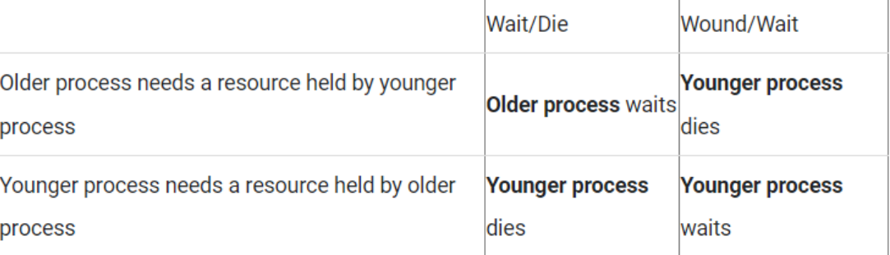
Deadlock Avoidance
Deadlock can be avoided if resources are allocated in such a way that it avoids the deadlock occurrence. There are two algorithms for deadlock avoidance.
Wait/Die
2. Wound/Wait
Both algorithms take process age into consideration while determining the best possible way of resource allocation for deadlock avoidance.

Slide 81
Starvation
Starvation occurs when a particular transaction consistently waits or restarted and never gets a chance to proceed further.
In a deadlock resolution, it is possible that the same transaction may consistently be selected as a victim and rolled back.
This limitation is inherent in all priority-based scheduling mechanisms.
In the Wound/Wait scheme, a younger transaction may always be wounded (aborted) by a long-running older transaction which may create starvation

Slide 82
Time Stamp Based Protocols
A timestamp is a tag that can be attached to any transaction or any data item, which denotes a specific time on which the transaction or data item had been activated in any way.
This protocol uses either system time or logical counter to be used as a time-stamp. Lock-based protocols manage the conflict among transactions at the time of execution, whereas timestamp-based protocols start working as soon as a transaction is created.
Every transaction has a timestamp associated with it, and the ordering is determined by the age of the transaction. A transaction created at 0002 clock time would be older than all other transactions that come after it.

Slide 83
A timestamp can be implemented in two ways.
The simplest one is to directly assign the current value of the clock to the transaction or the data item.
The other policy is to attach the value of a logical counter that keeps incrementing as new timestamps are required
.
The timestamp of a data item can be of the following two types:
W-timestamp (Q): This means the latest time when the data item Q has been written into.
R-timestamp (Q): This means the latest time when the data item Q has been read from

Slide 84
The timestamp ordering protocol ensures that any pair of conflicting read/write operations will be executed in their respective timestamp order. This is an alternative solution to using locks.
For Read operations:
If TS (T) < W-timestamp (Q), then the transaction T is trying to read a value of data item Q which has already been overwritten by some other transaction. Hence the value which T wanted to read from Q does not exist there anymore, and T would be rolled back.
If TS (T) >= W-timestamp (Q), then the transaction T is trying to read a value of data item Q which has been written and committed by some other transaction earlier. Hence T will be allowed to read the value of Q, and the R-timestamp of Q
should be updated to TS (T).

Slide 85
For Write operations:
If TS (T) < R-timestamp (Q), then it means that the system has waited too long for transaction T to write its value, and the delay has become so great that it has allowed another transaction to read the old value of data item Q. In such a case T has lost its relevance and will be rolled back.
Else if TS (T) < W-timestamp (Q), then transaction T has delayed so much that the system has allowed another transaction to write into the data item Q. in such a case too, T has lost its relevance and will be rolled back. Otherwise, the system executes transaction T and updates the W-timestamp of Q to TS (T)

Slide 86
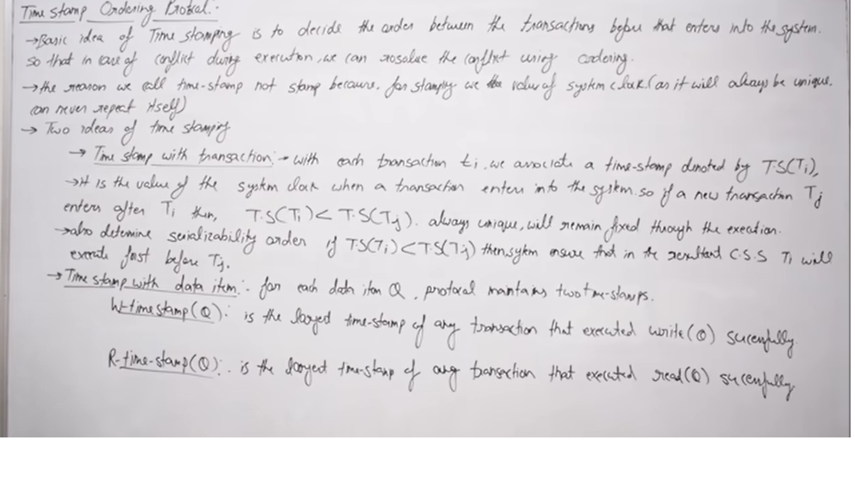

Slide 87
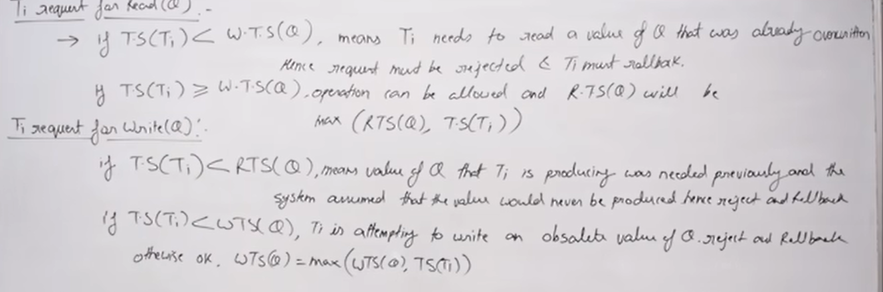

Slide 88
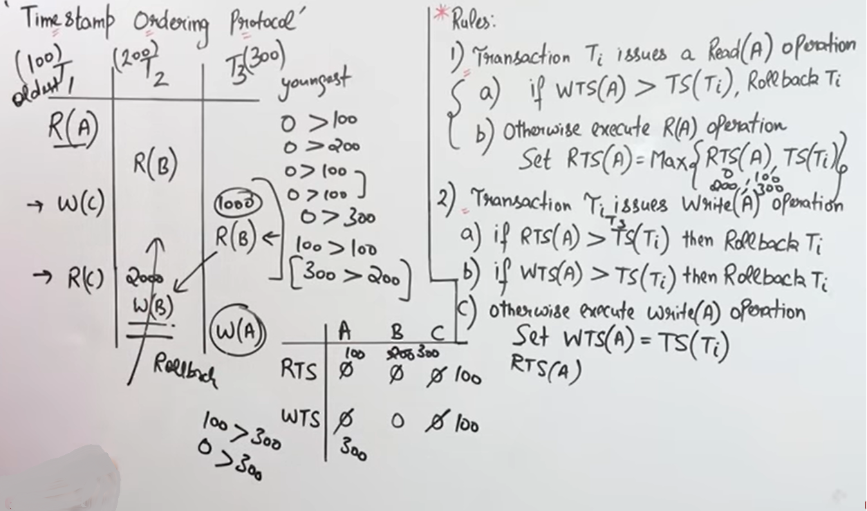

Slide 89
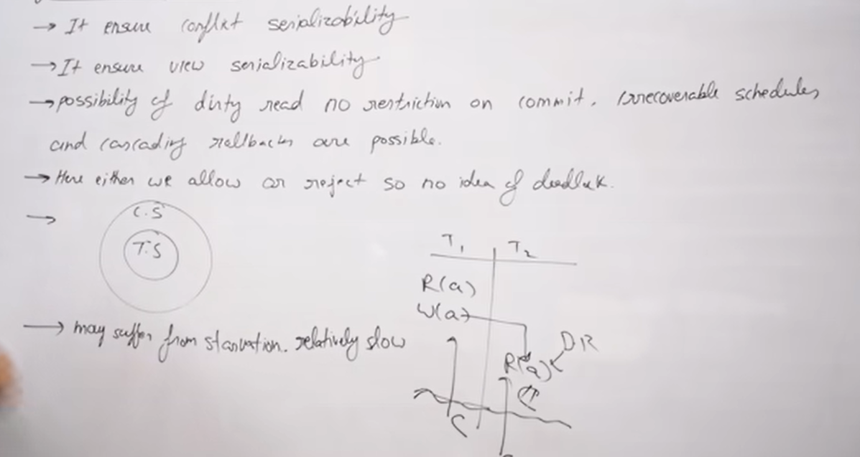

Slide 90
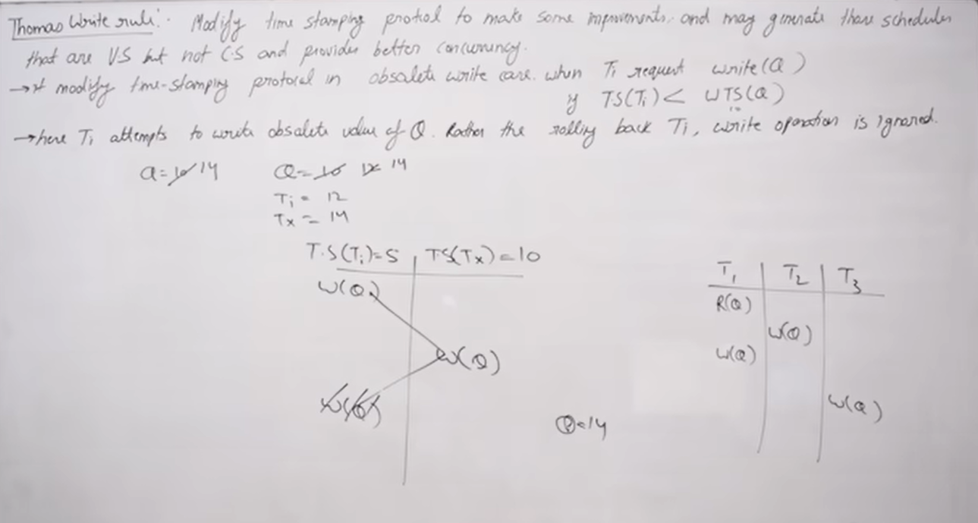

Slide 91
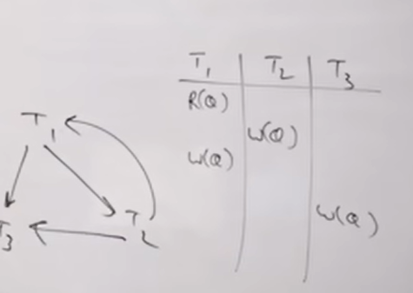
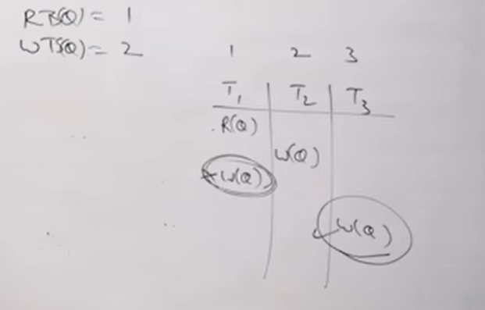
Checking conflict serializability
View serializable- Having blind write

Slide 92
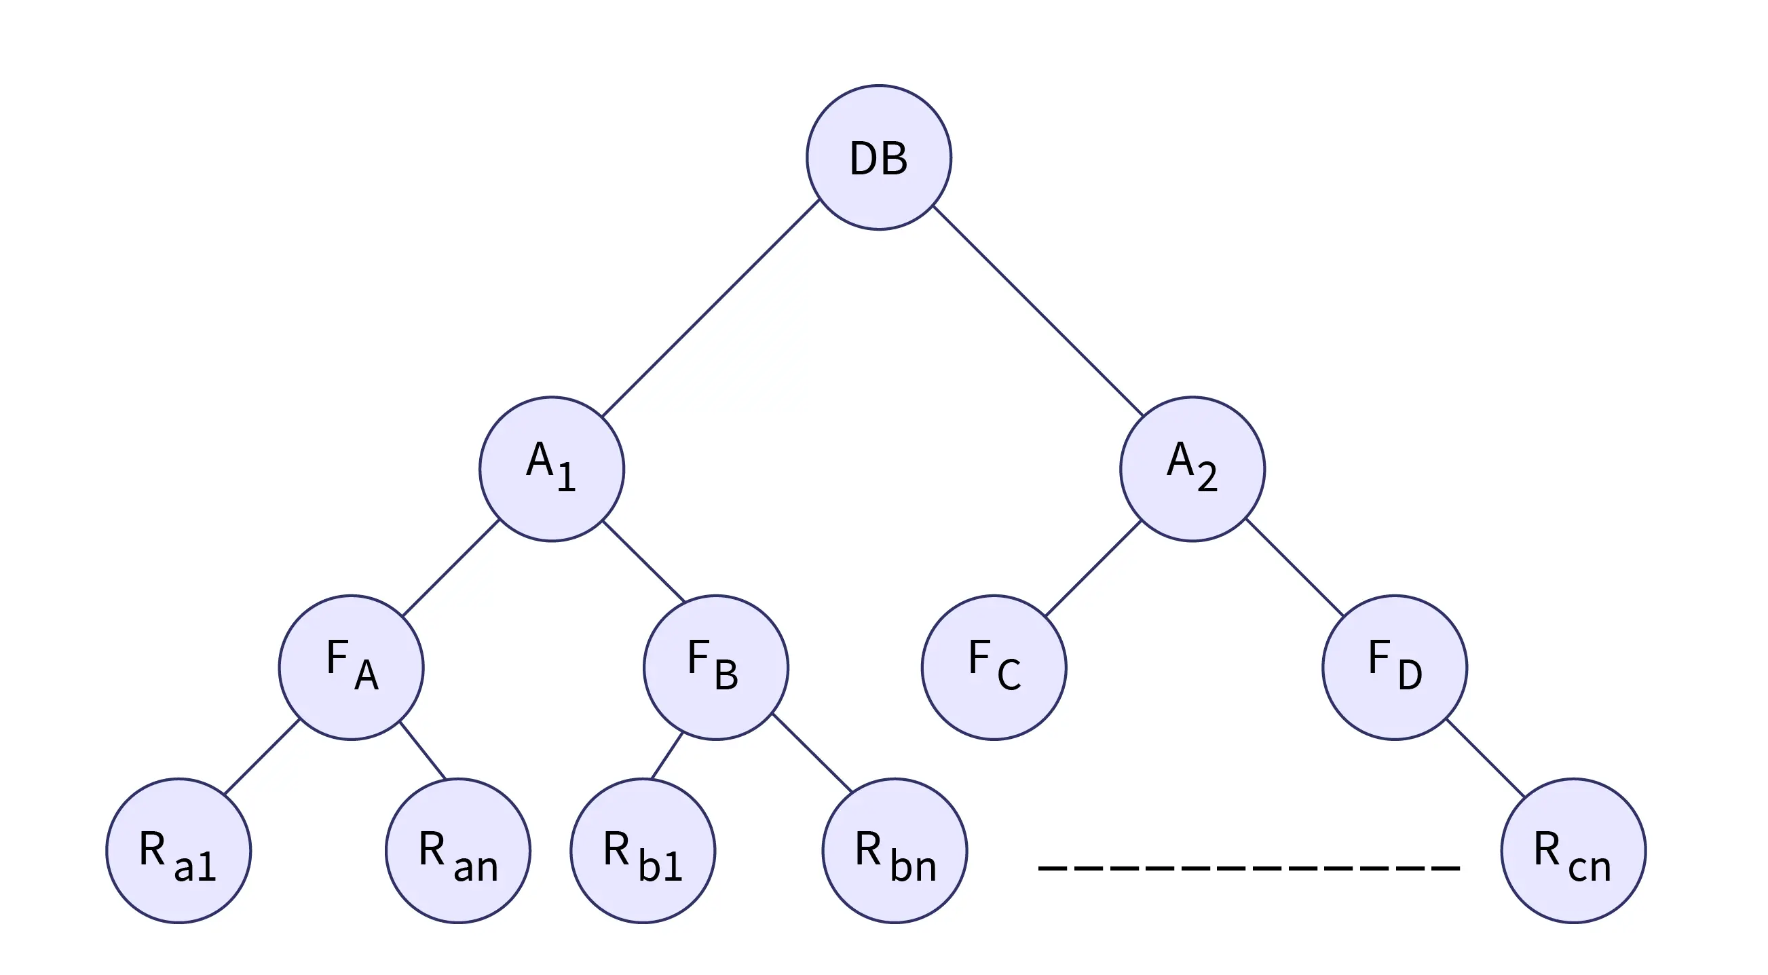
What is Granularity in DBMS?
Transactions in databases are atomic, which means when a transaction needs to access the values in the database, a locking protocol is used to lock the database.
Locking prevents other transactions from modifying or viewing the database simultaneously because other ongoing transactions are locked.
It is crucial to lock the database while performing a transaction optimally.
Locking an entire database unnecessarily can cost a loss of concurrency. We have a concept of multiple granularities in DBMS to solve this issue.
Database
Each node in the tree can be individually locked
Database areas
Files
Records

Slide 93
There are two problems with this approach:
If we want to apply a lock on a node, we need to ensure that no ancestor of the node is locked. To ensure that none of the ancestors is locked, we need to iterate from root to node to check any node in the path is not locked.
To acquire a lock on the entire database, the complete tree needs to be iterated to ensure none of the descendent (of the root node) is locked.
These limitations arise because we have a two-phase locking mechanism. The need to search the entire tree to acquire a lock on the entire database nullifies our concept of multiple granularities.
Shared locks: Shared locks are used while reading data only, and the lock prevents other transactions from updating the data but allows them to read the data.
Exclusive locks: When the data is being modified, exclusive locks prevent other transactions from reading or modifying the data.

Slide 94
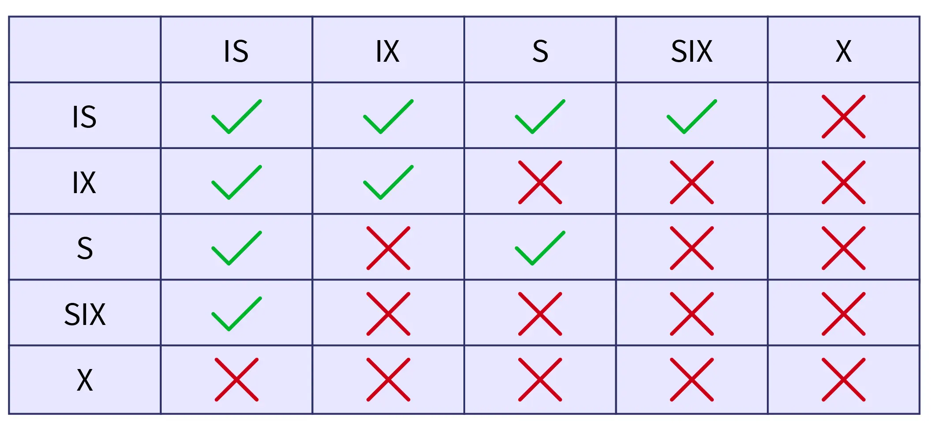
Different Types of Intention Mode Locks in Multiple Granularity
Intention Shared (IS) lock: If there is an Intention-shared lock on a node, then the lower-level tree only has explicit locking with the shared lock.
This means that a node can have an Intention Shared (IS) lock only when nodes at the lower level are locked with shared locks.
2. Intention Exclusive (IX) lock: Explicit lock on the lower-level tree from the node with either shared or exclusive lock.
3. Shared and Intention Exclusive (SIX) lock: In such a type of lock, the subtree of the locked node is explicitly locked in shared mode and with an exclusive mode lock at the lower level.

Slide 95
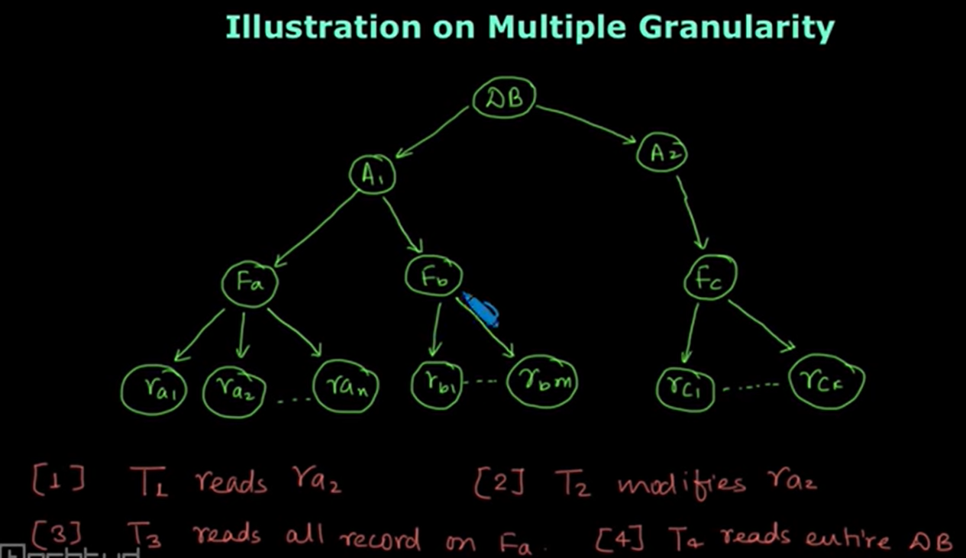

Slide 96
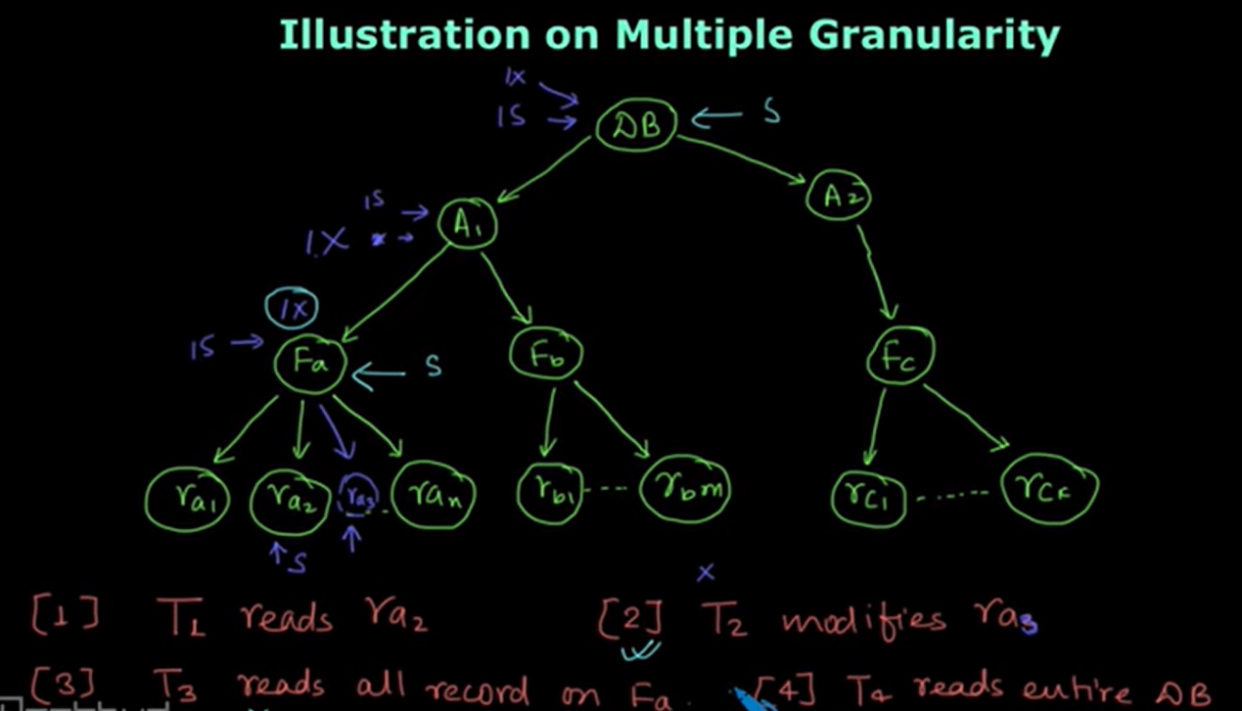

Slide 97
To ensure serializability in data, we use intention lock modes in multiple granularity protocols. If a transaction T attempts to lock a node, it needs to follow the following protocols:
The transaction T must follow the lock-compatibility matrix.
Transaction T first locks the root node (in any mode).
If the parent node of T has IX or IS lock, then transaction T will lock the node only in IS or S mode.
If the parent node of T has locked in mode SIX or IX, then transaction T will lock the node only in SIX, IX, or X mode.
If transaction T has previously not unlocked any node, then transaction T can lock a node.
If none of the children of transaction T is locked, only then can transaction T unlock a node.
The locks in multiple granularity are acquired from top to down (top-down order), but the locks must be released in the bottom-up order.

Slide 98
This way, multiple granularities improve concurrency and reduce the overhead on locks, but deadlocks can still be possible in multiple granularity protocol, just like in the two-phase locking protocol.
Conclusion
A locking protocol locks the database whenever a transaction wants to access the database.
Granularity is the size of data that is allowed to be locked.
Multiple granularity is hierarchically breaking up our database into smaller blocks that can be locked.
Other than shared and exclusive locks, three additional locks are introduced in multiple granularity locking protocols:
Intention Shared (IS)
Intention Exclusive (IX)
Shared and Intention Exclusive (SIX)

Slide 99
Data Recovery in DBMS
It is the method of restoring the database to its correct state in the event of a failure at the time of the transaction or after the end of a process.
Need for recovery of data
The sources of failure are:
Due to hardware or software errors, the system crashes, which ultimately results in loss of main memory.
Failures of media, such as head crashes or unreadable media that result in the loss of portions of secondary storage.
There can be application software errors, such as logical errors that are accessing the database that can cause one or more transactions to abort or fail.
Natural physical disasters can also occur, such as fires, floods, earthquakes, or power failures.
Carelessness or unintentional destruction of data or directories by operators or users.
Damage or intentional corruption or hampering of data (using malicious software or files) hardware or software facilities.

Slide 100
Whatever the grounds for the failure are, there are two principal things that you must consider:
Failure of main memory, including that database buffers.
Failure of the disk copy of that database.
Recovery Techniques in DBMS
The recovery techniques in DBMS maintain the properties of atomicity and durability of the database.
A system is not called durable if it fails during a transaction and loses all its data and a system is not called atomic, if the data is in a partial state of update during the transaction.
The data recovery techniques in DBMS make sure, that the state of data is preserved to protect the atomic property and the data is always recoverable to protect the durability property.
The following techniques are used to recover data in a DBMS,
Log-based recovery in DBMS.
Recovery through Deferred Update
Recovery through Immediate Update

Slide 101
Log-based Recovery
Any DBMS has its own system logs that have the records for all the activity that has occurred in the system along with timestamps on the time of the activity.
Databases handle different log files for activities like errors, queries, and other changes in the database. The log is stored in the files in the following formats,
The structure [start_transaction, T] denotes the start of execution of transaction T.
[write_item, T, X, old_value, new_value] shows that the value of the variable, X is changed from old_value to new_value by the transaction T.
[read_item, T, X] represents that the value of X is read by the transaction T.
[commit, T] indicates the changes in the data are stored in the database through a commit and can't be further modified by the transaction. There will be no error after a commit has been made to the database.
[abort, T] is used to show that the transaction, T is aborted.
We can use these logs to see the change in the state of the data during a transaction and can recover the data to the previous state or new state.

Slide 102
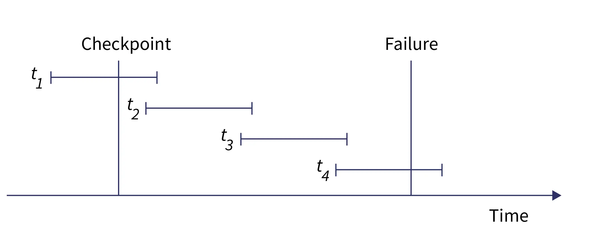
An undo operation can be used to examine the [write_item, T, X, old_value, new_value] operation and retrieve the state of data to old_data. A redo operation can be done to convert the old state of data to the new state that was lost due to system failure and is only possible if the [commit, T] operation is performed.
A checkpoint is made after all the records of a transaction are written to logs to transfer all the logs from the local storage to the permanent storage for future use.

Slide 103
Deferred Update and an Immediate Update
Deferred updates and immediate updates are database recovery techniques in DBMS that are used to maintain the transaction log files of the DBMS.
In the Deferred update, the state of the data in the database is not changed immediately after any transaction is executed, but as soon as the commit has been made, the changes are recorded in the log file, and the state of data is changed.
In the Immediate update, the database is updated directly at every transaction, and a log file is maintained containing the old and new values.

Slide 104
Deferred Update | Immediate Update
During a transaction, the changes are not applied immediately to the data | An immediate change is made in the database as soon as the transaction occurs.
The log file holds the changes that are going to be applied. | The log file holds the changes along with the new and old values
Buffering and Caching are used in this technique | Shadow paging is used in this technique
More time is required to recover the data when a system failure occurs | Many I/O operations are performed to manage the logs during the transaction
If a rollback is made, the log files are destroyed, and no change is made to the database | If a rollback is made, the old state of the data is restored with the records in the log file

